Slide 1

“Coffee Shop Management System”
Tuljaram Chaturchand College of Arts, Science and Commerce
Baramati
PROJECT TITLE
PROJECT GUIDE:
Prof. M.R. SASTE
SUBMITTED BY:
TEJAS. R. SHINDE [13214]
TEJAS. S.TAWARE[13217]

Slide 2
INTRODUCTION
The restaurant industry is known for particularly low profit margins. This project focuses on small businesses, café, especially those that serve fast food .
The backbone of experimentation for applying though these accounting processes is local café restaurant in which the managers are in warehouse of how food cost and operating expenses could be combined to provide meaningful cost information.
The café management system. Is existing mishaps cafeteria to manager cafeteria daily processes such as order & bill.
This process also gives the interface for bill painting purpose in instant time.

Slide 3
SCOPE OF SYSTEM
The scope of the Coffee Shop Management System includes the following key aspects:
It is designed to increase operational efficiency, saving our money and time maximizing profit and provide more security. It is designed to avoid paperwork.
Cafeteria Management especially manage the menu items, gives interface to the orderings, expenditure reports, user to manage the items and inventory.
Whereas it maintains the relationship between customers and the admin in a technical way, with the help of coffee shop management software, the software will facilitate creation of different reports.

Slide 4
EXISTING SYSTEM
The existing system for Coffee Shop Management typically involves manual and paper-based processes, which can be time-consuming, error-prone, and inefficient.
Manual Data Entry: Product information is often stored in physical files or spreadsheets, requiring manual data entry and updating.
Limited Accessibility: The existing system for Coffee Shop Management typically involves manual and paper-based processes, which can be time-consuming, error-prone, and inefficient.

Slide 5
PROPOSED SYSTEM
Centralized Employee Database: To overcome all the problems faced in the existing system, we apply billing as well as other facilities that are not present in the existing system.
Inventory and Stock Management: Monitor and manage the stock of coffee ingredients and other consumables. Simple menu set up, user friendly order management.
By implementing the proposed Employee Management System, organizations will benefit from increased efficiency, improved data accuracy, streamlined processes, enhanced communication, and better employee engagement.

Slide 6
MODULES
Multiple user access: Allows multiple type users admin/employee
Functional Admin panel: Allows admins to manage the whole system
CRUD functionalities: Allows admin to create, read, update and delete their product data in a managed format
Secure login option for admin
Allows employee to manage billing details of products easily.
Report Generation for the products to track the inventory

Slide 7
HARDWARE REQUIREMENT
Hardware Requirements -
Processor: Intel I3 2.8 GHz Processor and Above
RAM: 4 GB and Above
Operative Memory required for the software 500MB
500 MB of free disk space for Eclipse installation
Additional disk space for your projects and any additional plugins or extensions

Slide 8
SOFTWARE REQUIREMENT
Operating System: WINDOWS OS (Windows 10,11)
Frontend: VB.NET
Backend: SQL Server For Database Connectivity
Integrated Development Environment (IDE): Visual Studio 2019

Slide 9
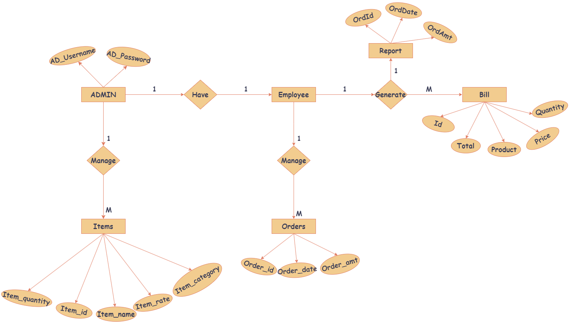
ER-DIAGRAM

Slide 10
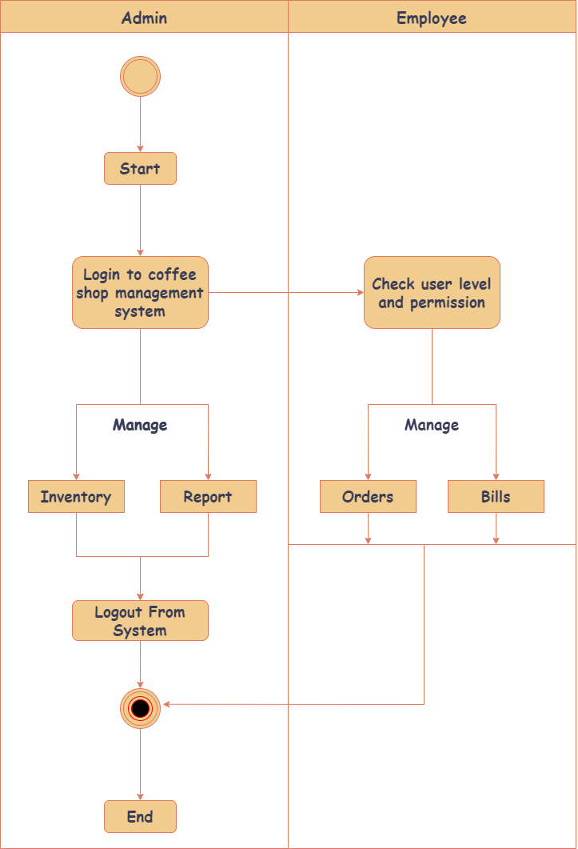
ACTIVITY DIAGRAM

Slide 11
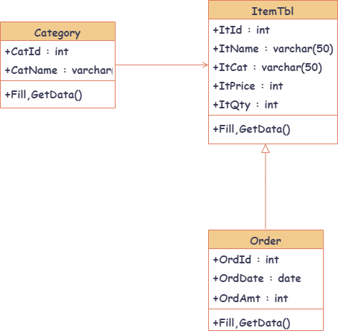
CLASS DIAGRAM

Slide 12
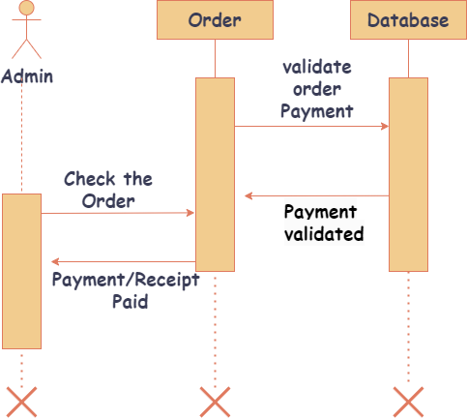
SEQUENCE DIAGRAM

Slide 13
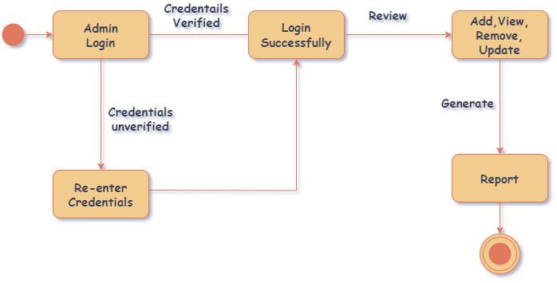
STATE CHART

Slide 14
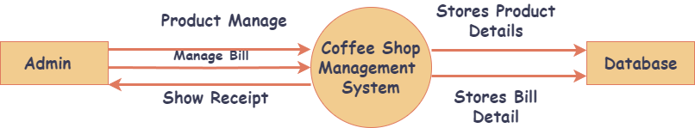
DFD LEVEL - 0

Slide 15
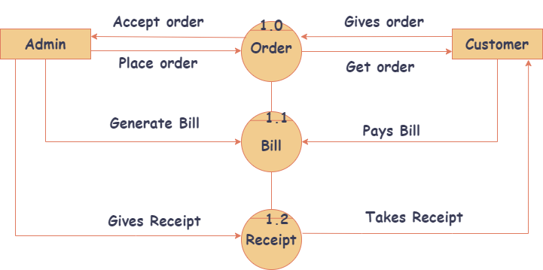
DFD LEVEL - 1

Slide 16
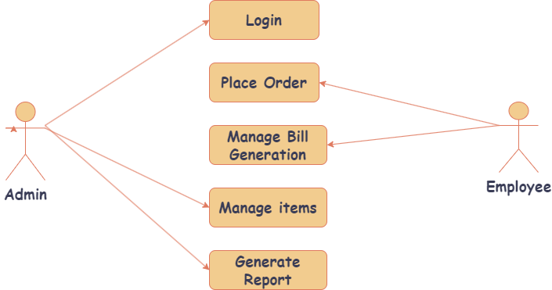
USE-CASE DIAGRAM

Slide 17
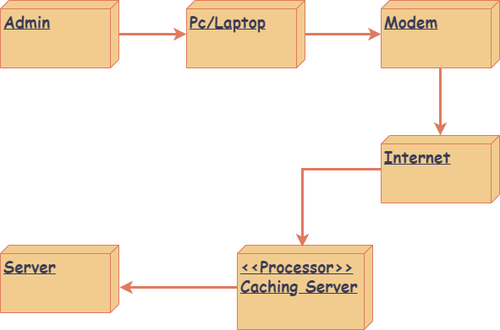
DEPLOYMENT DIAGRAM

Slide 18
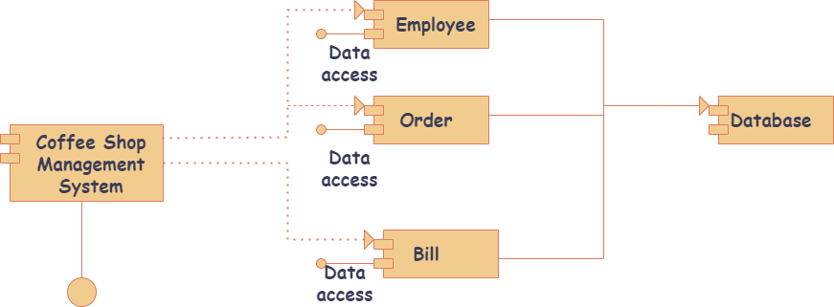
COMPONENT DIAGRAM

Slide 19
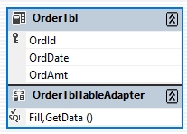
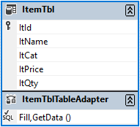
DATA DICTIONARY

Slide 20
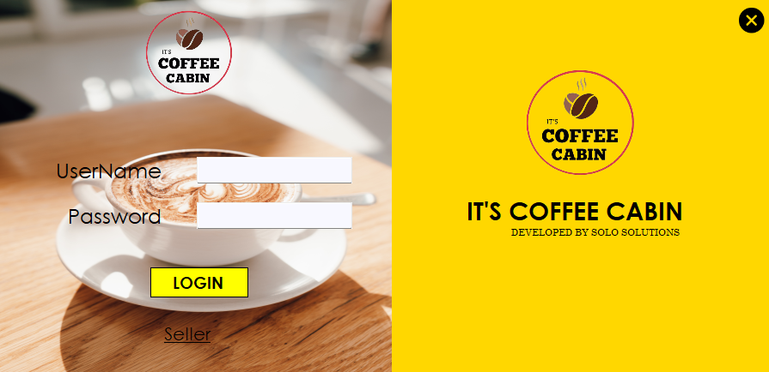
LOGIN FORM

Slide 21
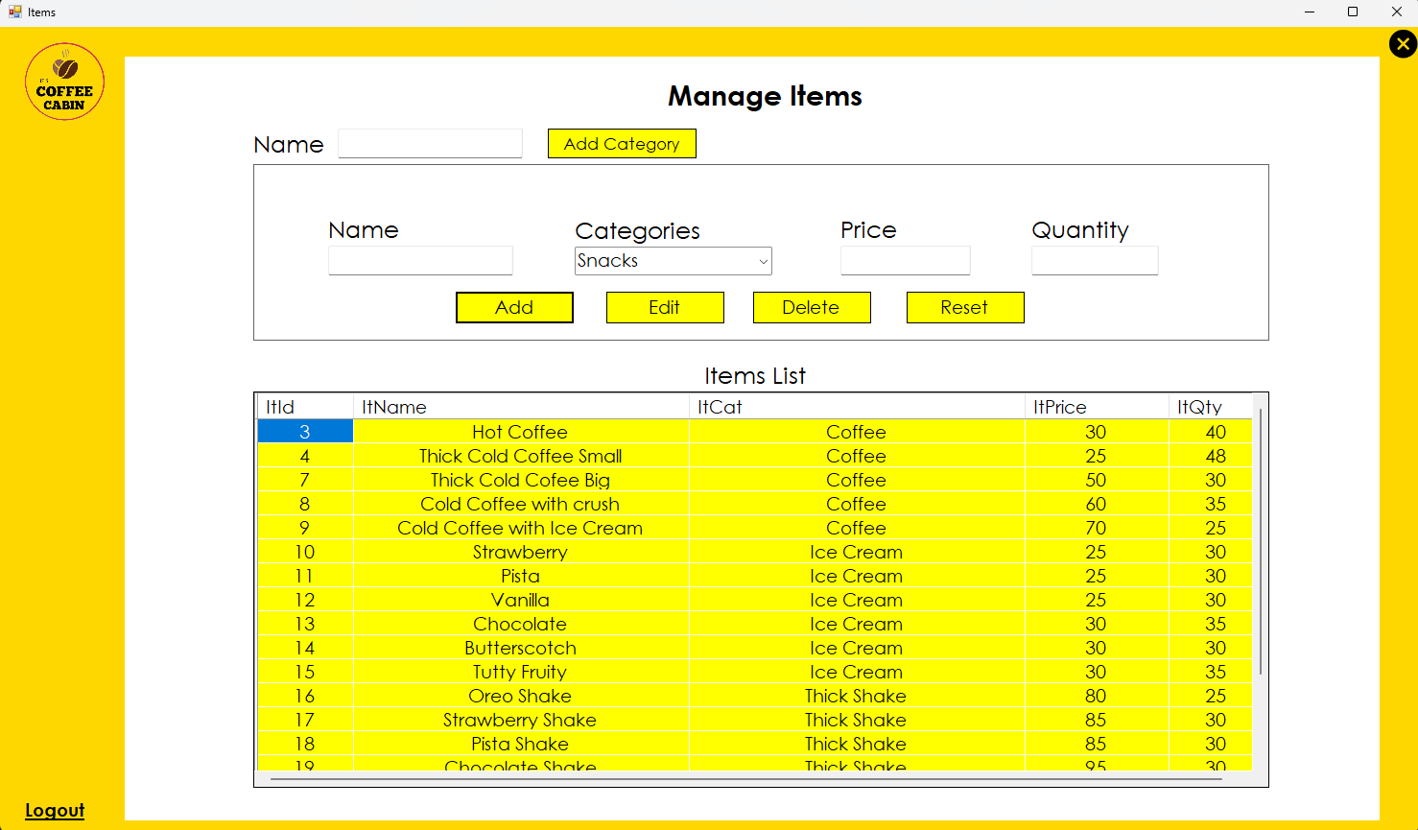
ADMIN DASHBOARD

Slide 22
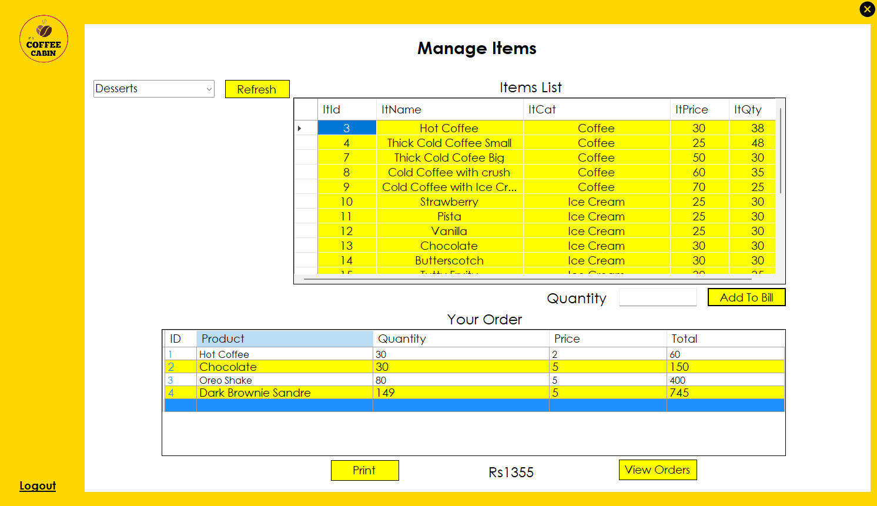
BILLING DASHBOARD

Slide 23
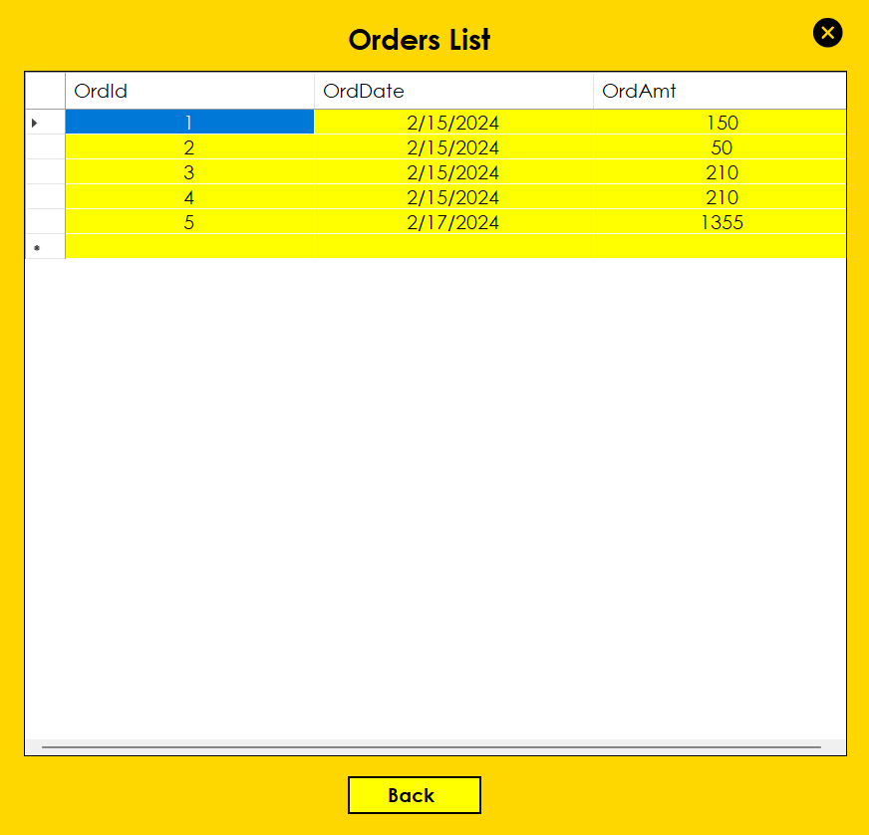
ORDER’S LIST

Slide 24
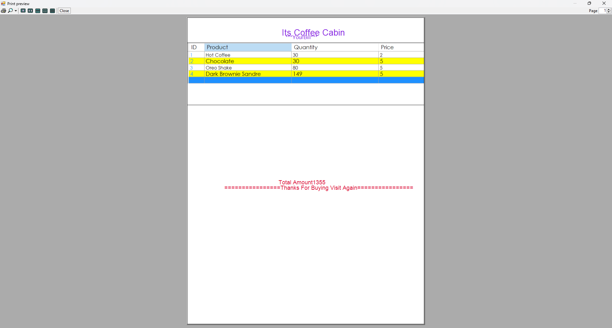
BILL PREVIEW

Slide 25
THANK YOU!

